Slide 1


Denver Airbnb Analysis: Key Insights and Trends for 2024
By: Briana Palencia, Edda Phillips, Jigna Chaudhary, Pratik More
CU Denver Business School
BANA 6620: Computing for Business Analytics
Dr. Ziyi Wang
December 11, 2024

Slide 2

Introduction
Overview of Airbnb:
Airbnb is a leading platform in the hospitality industry, offering diverse accommodations worldwide.
In 2023, 448 million Airbnb nights were booked globally (Statista, 2023).
Denver as a Travel Destination:
Denver has become a growing tourist hotspot, with a 3% rise in visitors in 2023 (Visit Denver, 2023).
The city’s popularity makes high-performing Airbnb listings crucial to meeting traveler demands.
Objective:
Analyze and identify characteristics that distinguish high-performing Airbnb listings in Denver.
Provide actionable insights for hosts to improve listing performance.
Notes:
Edda

Slide 3
Key Findings
To be qualified as a superhost, one must maintain an average rating of 4.8 or higher, book at least 100 nights a year, and respond to 90% of inquiries within 24 hours (Airbnb, 2024). However, in our analysis, we noticed that hosts who achieve superhost status consistently demonstrate higher performance metrics across several dimensions, including:
Room type offered
Wider, more variable price range
Stronger guest satisfaction through guest reviews
Higher acceptance rates (low cancellation rate)
Neighborhood appeal/popularity
Response time and response rate to guest inquiries
More years experience
We used these variable to create an OpenAI model that can predict whether a person is a superhost (or close to becoming one) based on inputs.
Notes:
Edda

Slide 4
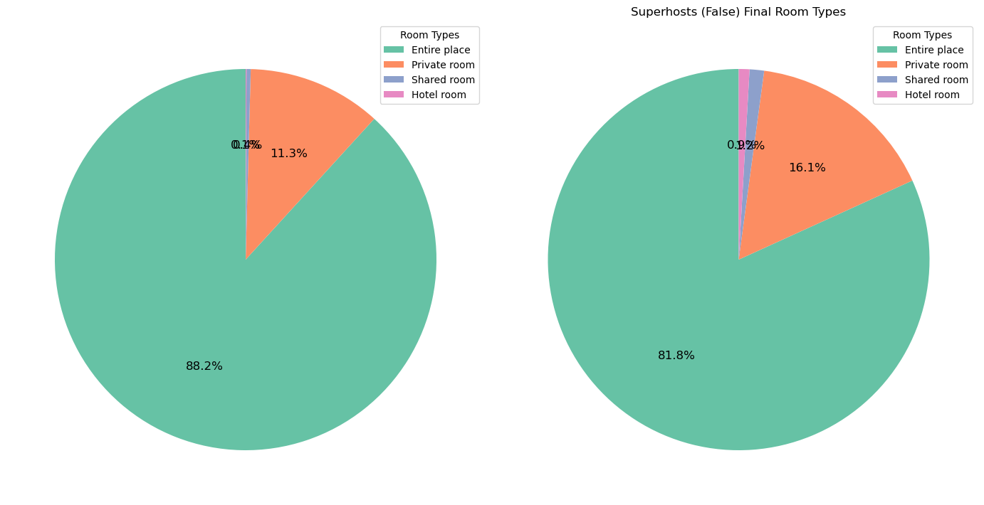
Room Types by Superhost Status
Pie charts showing the proportion of room types offered by superhosts and non-superhosts.
Insights: Majority offer 'entire place' listings (88% for superhosts, 82% for non-superhosts)
Notes:
Edda

Slide 5
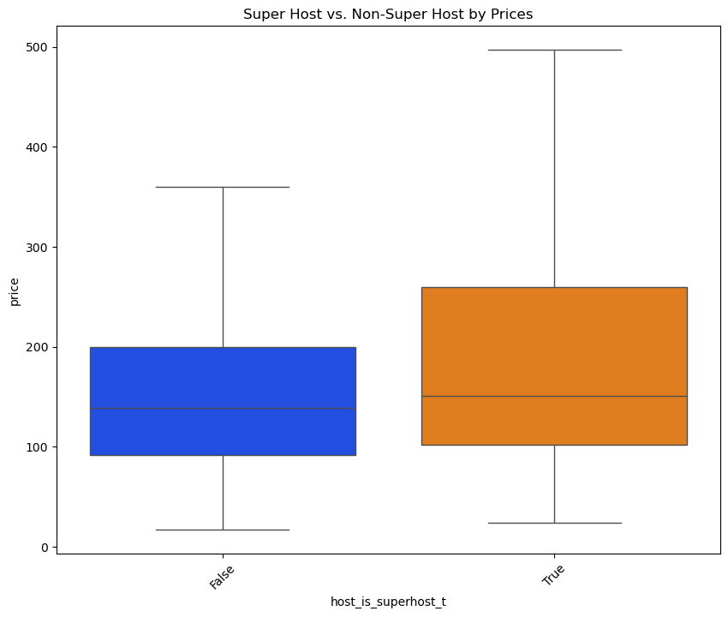
Pricing Analysis
Boxplots comparing price ranges for superhosts and non-superhosts.
Insight: Superhosts charge higher rates but with more variability.
Notes:
Edda

Slide 6
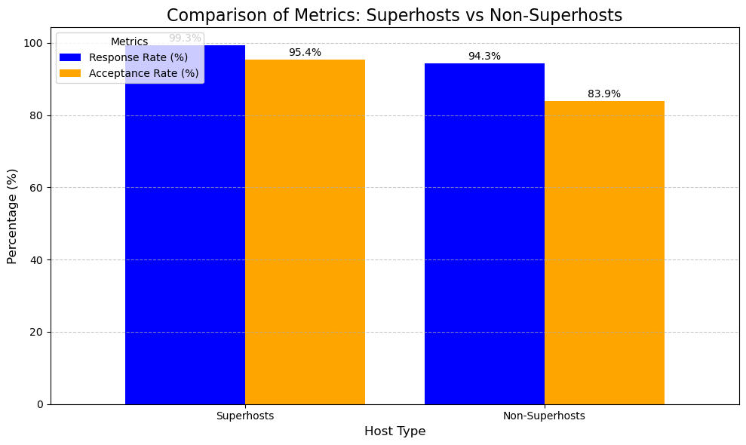
Response and Acceptance Rates
Side-by-side bar charts or comparisons of response times and rates.
Insight: While guest ratings are similar, Non-Superhosts cancel significantly more bookings, emphasizing reliability as a key factor for Superhost status.
Notes:
Jigna

Slide 7
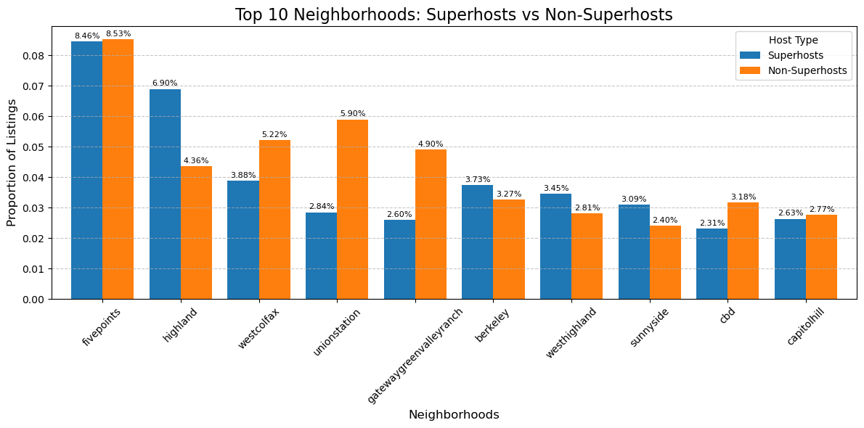
Proportion Distribution (%) of Superhosts vs. Non-Superhosts in Top 10 Neighborhoods by Listing Count
Bar chart showing the distribution of superhosts and non-superhosts in the top 10 neighborhoods.
Insight: Popular neighborhoods like Five Points have a balanced mix of hosts.
Notes:
Jigna

Slide 8
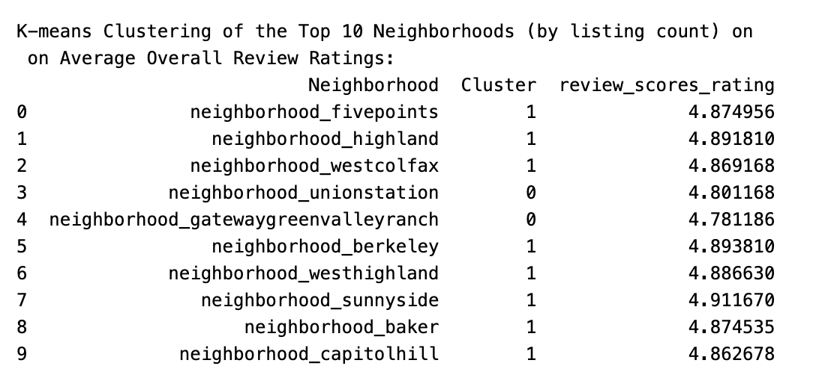
Clustering the Top 10 Neighborhoods (by Listing Count) Based on Average Overall Review Ratings
Visual of k-means clustering results.
Insight: Neighborhoods appeal does not significantly impact listing performance.
Notes:
Briana

Slide 9
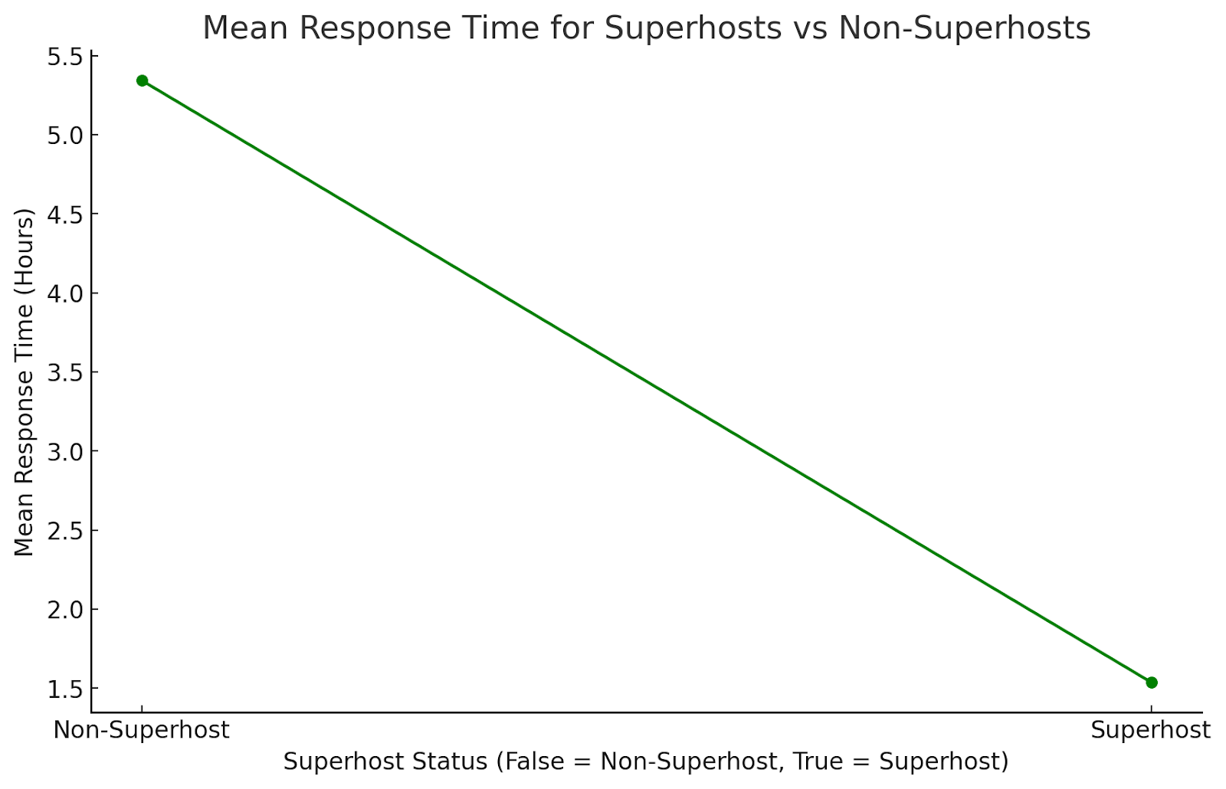
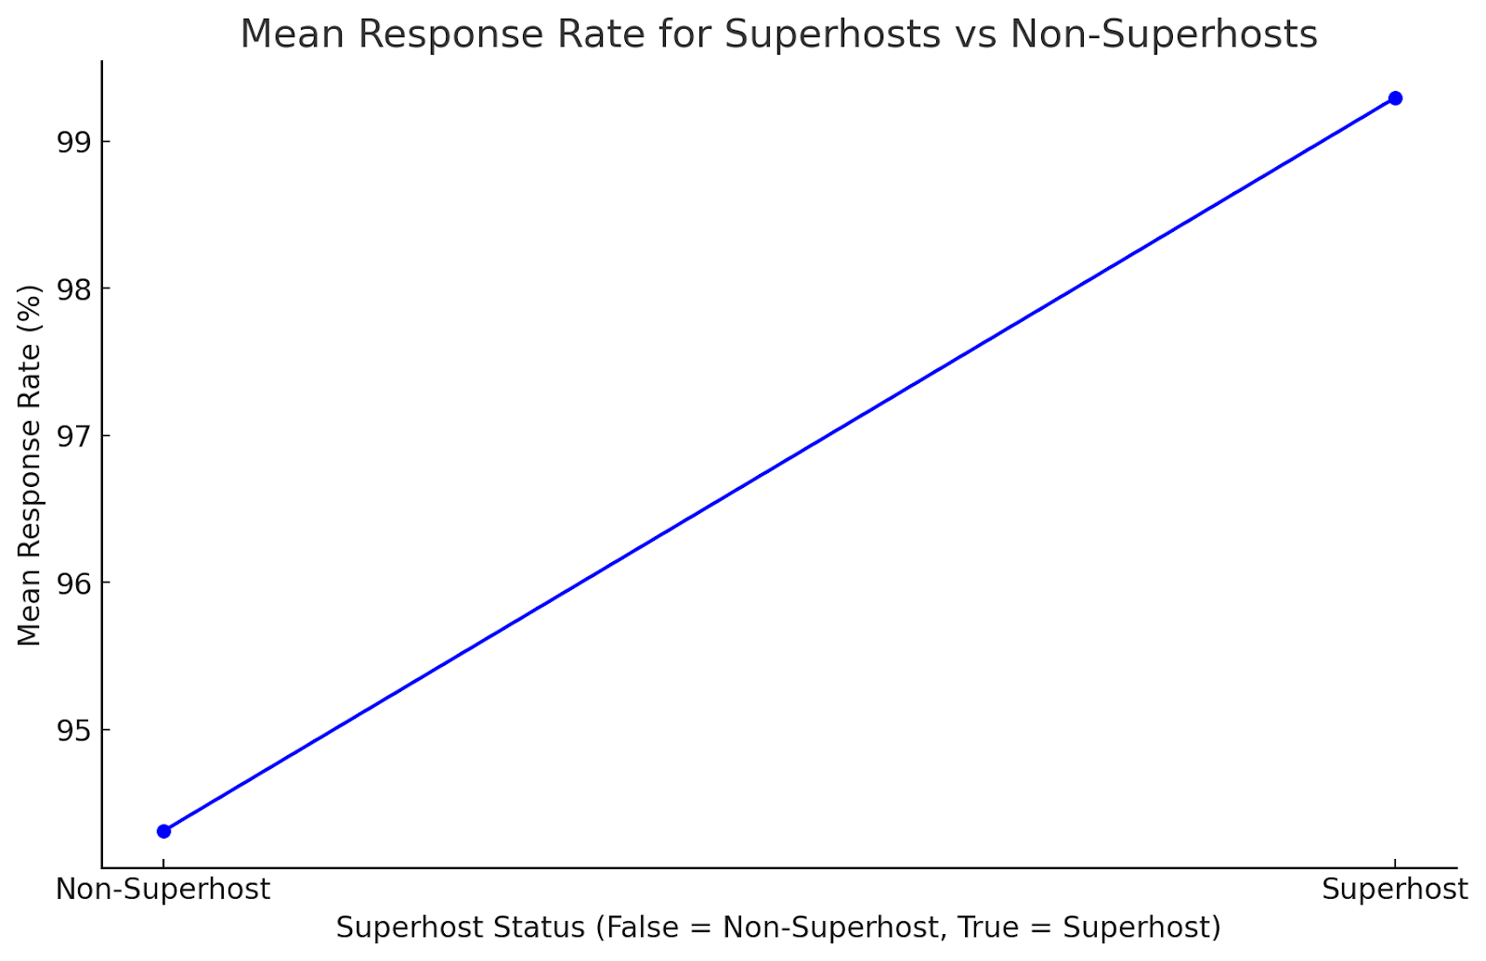
Average Response Rate and Average Response Time of Superhosts and Non-Superhosts
Line plots of average response rate and average response time from superhosts and non-superhosts.
Insight: Superhosts prioritize timely communication.
Notes:
Briana

Slide 10
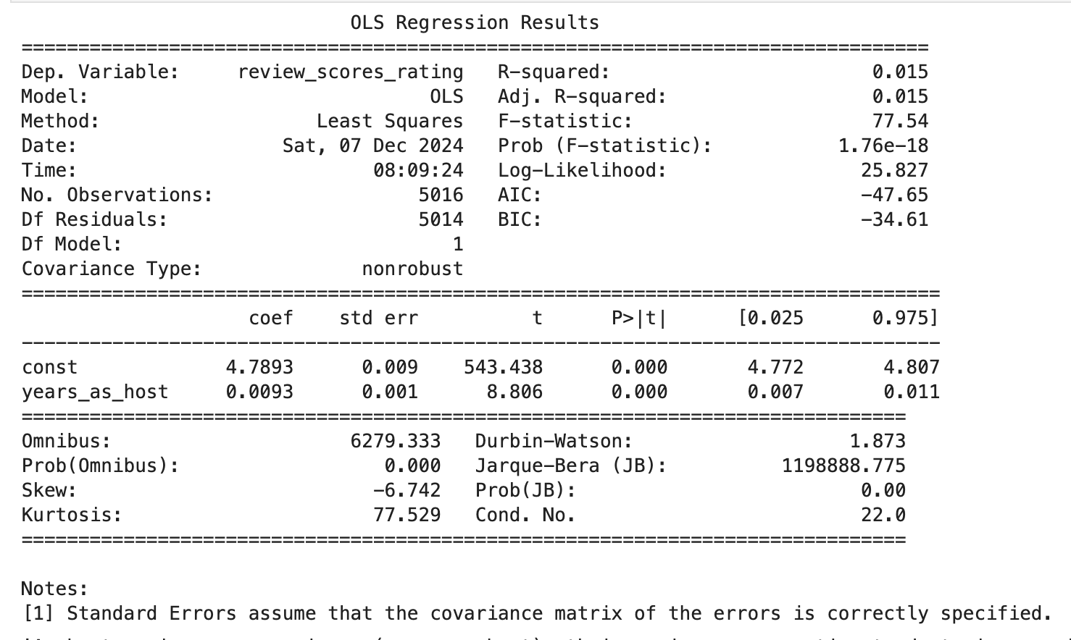
Host’s Experience vs. Overall Review Rating
Linear regression revealing the baseline review score and the annual improvement in overall rating as a host
Insight: Host experience plays a key role in enhancing Airbnb ratings
Notes:
Briana

Slide 11
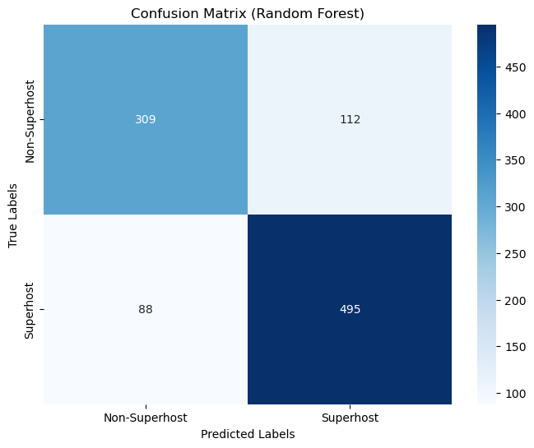
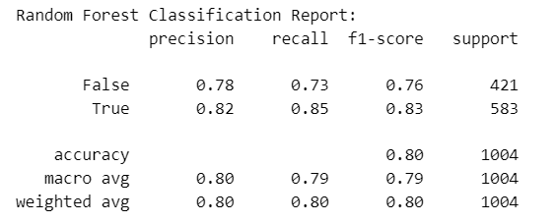
Confusion Matrix and Random Forest Model Insights
Performance Metrics:
Precision for Superhosts: 82%
Recall for Superhosts: 85%
Overall Accuracy: 80%
Key Insights:
Random Forest significantly outperforms Logistic Regression in recall and F1-Score.
Higher recall ensures most Superhosts are correctly identified.
Notes:
Pratik

Slide 12
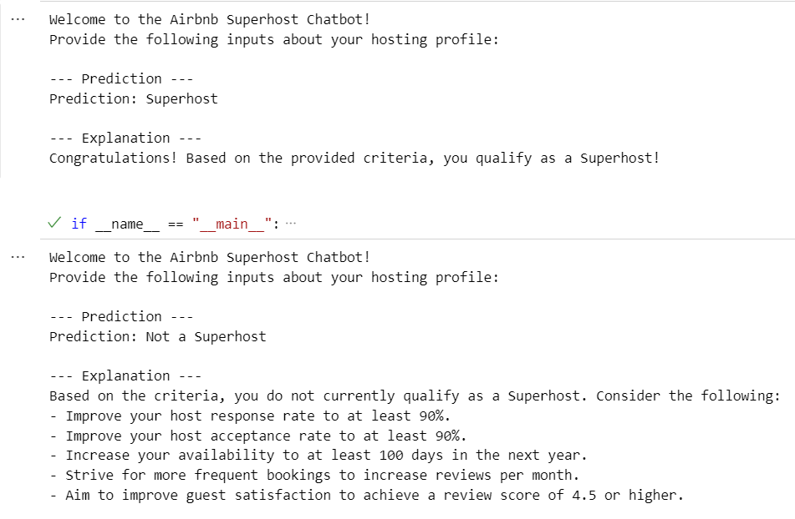
Illustrative Output of Airbnb Superhost Chatbot
Purpose:
Predicts whether a host qualifies as a Superhost.
Provides actionable recommendations based on data inputs.
Key Features:
Inputs: Response Rate, Acceptance Rate, Price, Reviews, Ratings, Availability.
Outputs:
Prediction: Superhost or Not a Superhost.
Recommendations: Improve key metrics like response rate or reviews.
Notes:
Pratik

Slide 13
Conclusion
Superhost Success Factors: Responsiveness, guest satisfaction, and reliability are key drivers of high performance.
Neighborhood Impact: Neighborhood popularity does not solely predict success; quality hosting practices matter more.
Room Type Consistency: Offering "entire place" listings remains the most popular and successful option for both superhosts and non-superhosts.
Actionable Insights: Hosts can improve performance by focusing on response times, reducing cancellations, and setting competitive pricing.
Future Opportunities: As Denver's tourism grows, maintaining high-quality listings and leveraging guest feedback will be critical for staying competitive.
Notes:
Pratik

Slide 14
References
Airbnb. (2024). Superhost. Airbnb. Retrieved from https://www.airbnb.com/superhost
Inside Airbnb. (2024). Denver data. Retrieved from https://insideairbnb.com/denver/
OpenAI. (2024). ChatGPT (Dec 15 version) [Large language model]. OpenAI. Retrieved from https://openai.com/chatgpt
Statista. (2023). Airbnb - statistics & facts. Retrieved from https://www.statista.com/topics/2273/airbnb/#topicOverview
Visit Denver. (2023). Denver tourism continues strong growth in 2023. Retrieved from https://www.denver.org/articles/post/denver-tourism-continues-strong-growth-in-2023/
Wikimedia Commons. (2009). Denver skyline [Photograph]. Wikimedia Commons. Retrieved from https://commons.wikimedia.org/wiki/File:Denver_skyline.jpg

Slide 15


